Slide 1

CAR ANALYTICS
BY TANVI SADAKAL

Slide 2
PROJECT DESCRIPTION
The dataset includes various attributes related to car manufacturers, engine performance, fuel efficiency (MPG), and more.
Through extensive data analysis, we aim to uncover meaningful trends, patterns, and insights within the dataset.
This analysis will enable car manufacturers to make informed, data-driven decisions to optimize their product offerings and ensure competitive pricing in the market.
The primary objective of our project is to leverage this dataset to predict car prices accurately.

Slide 3
APPROACH
Through this process, we enhance our understanding of how data can guide and optimize the car manufacturing process
By analyzing trends and variations in car prices, we gain insight into the factors that drive pricing dynamics.
Excel's diverse range of tools enables us to extract meaningful information from the dataset, empowering us to make data-driven decisions.

Slide 4
TECH-STACK
The analytics procedure is carried out on the software – MICROSOFT EXCEL.
Excel is a powerful tool, with a wide range of tools for analysis and visualization.

Slide 5
Insights
Popularity of Different Market Categories.
As plotted in the graph, we can see that Flex Fuel, Diesel and Crossover are the two most popular market categories.

Slide 6
2. Price Variation Vs. Engine HP :
From the plotted graph, we can see that the price of the car rises as the power of the engine rises.

Slide 7
3. Important Car Features:
After conducting a regression analysis, we determined that the price of cars is primarily dependent on three key factors: engine cylinders, engine power, and MPG.
The bar graph gives the idea.

Slide 8
4. Price Vs. Manufacturers:
From the graph, we can conclude that Bugatti has the highest average price of its cars.
Maserati and Pontiac are the following companies with the highest car prices.

Slide 9
5. Fuel efficiency Vs. engine cylinders:
From the graph, we can see that fuel efficiency decreases as the number of cylinders increases.

Slide 10
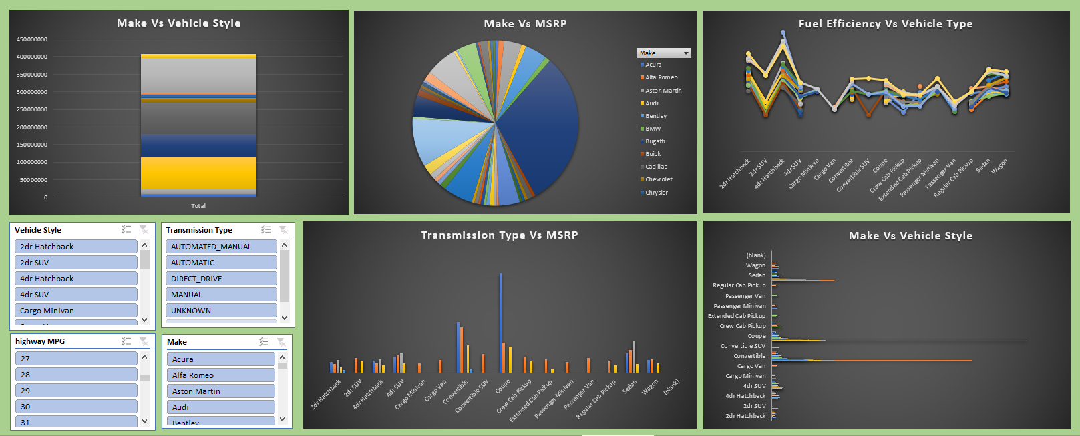
DASHBOARD

Slide 11
RESULTS
We can see that the most popular categories are: Flex fuel, diesel and Crossover.
Price of a car increases exponentially with an increase in engine power.
Car prices majorly depend on the Engine cylinders followed by Engine power and the MPG.
The car manufacturers like Bugatti have the highest average price of their cars followed by Maserati and Ferrari.
The fuel efficiency decreases as the number of cylinders increases.

Slide 12
THANK YOU
tanvisadakal@gmail.com

